Slide 1
Value Management
Project Management
Year 4

Slide 2
Concept of Value
The concept of Value relies on the relationship between the satisfaction of many differing needs and the resources used in doing so.
The fewer the resources used or the greater the satisfaction of needs, the greater the value.
Stakeholders, internal and external customers may all hold differing views of what represents value.

Slide 3
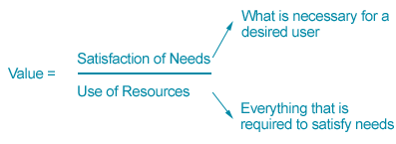
Value Management

Slide 4
Value Management
The aim of Value Management is to reconcile these differences and enable an organization to achieve the greatest progress towards its stated goals with the use of minimum resources

Slide 5
Terminology
"Value Management" encompasses both Value Engineering and Value Analysis.
The three phrases are interchangeable.
Over the years, the term "Value Analysis" has generally become associated with applying value techniques to systems, organizations, strategic planning, standards, quality control and environmental impacts - that is, items that do not require heavy engineering input.

Slide 6
Terminology
"Value Engineering" implies the application of value techniques utilizing the engineering and architectural disciplines to the design of products, facilities, renovations etc.
Value Management combines both terms and the value techniques they share to provide value from plan development through realization, project conception through final construction, or product idea through production.

Slide 7
Value Management
The Value Management Approach involves three root principles:
a continuous awareness of value for the organization, establishing measures or estimates of value, monitoring and controlling them;
a focus on the objectives and targets before seeking solutions;
a focus on function, providing the key to maximize innovative and practical outcomes.

Slide 8
FAST
Functions and Function Analysis are fundamental to the Value Management methodology, employing where appropriate FAST (Function Analysis Systems Technique) diagrams to define the Highest Order functions, the Basic Functions and the Secondary Functions of a Business, Program, Product or Project.
The consideration of functions enables a Study Team to focus on the essentials to make it work, removing, if necessary, those things that are not essential, or that are "nice to have".
It also helps to identify items that can serve several functions.

Slide 9
FAST
FAST starts with the basic premise that if you understand the problem, then you are already half way there to solving it.
FAST is a means of ‘drilling down’ through attributes, processes and procedures in order to identify non-value added elements, or where time/money is being wasted
FAST can be applied to Business Processes, Project Objectives, or Product Attributes

Slide 10
Example – Internal Wall
Main Function
Division of space
Secondary Functions
Platform for M&E Services
Architectural Feature
Possible Added Value Functions
Structural Element

Slide 11
FAST
Overview
http://www.value-eng.org/pdf_docs/monographs/FAbasics.pdf

Slide 12
FAST
Determinate Logic
http://www.value-eng.org/pdf_docs/monographs/FAbasics.pdf

Slide 13
FAST
The ‘How’ and ‘Why’ directions are always along the critical path
The ‘When’ direction indicates an independent / supporting function (up) or an activity (down)
http://www.value-eng.org/pdf_docs/monographs/FAbasics.pdf

Slide 14
FAST
How is the function to be accomplished
By B
Why is it necessary
To satisfy A
When it occurs, what else happens
C or D
http://www.value-eng.org/pdf_docs/monographs/FAbasics.pdf

Slide 15
FAST
AND function
http://www.value-eng.org/pdf_docs/monographs/FAbasics.pdf

Slide 16
FAST
OR Function
http://www.value-eng.org/pdf_docs/monographs/FAbasics.pdf

Slide 17
Reference
On Ebrary
Yang, Kai, Design for Six Sigma Service, (Chapter on Value Management), McGraw-Hill, 2005

Slide 18
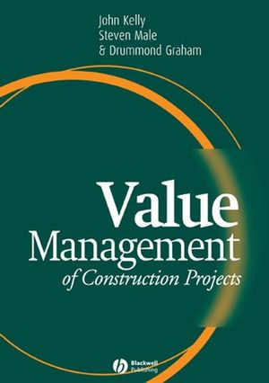
Further Reading
Kelly J. Male S. Graham D. (2004), Value Management of Construction Projects, Wiley-Blackwell Publishing
ISBN 978-0-632-05143-4

Slide 19
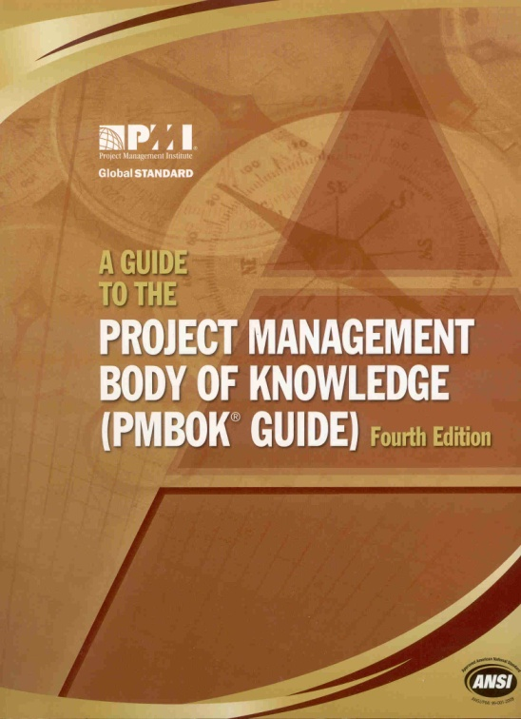
Next Lecture
Reading:
‘A Guide to the Project Management Body of Knowledge’
Chapter 10
Project Communications Management

